Slide 1


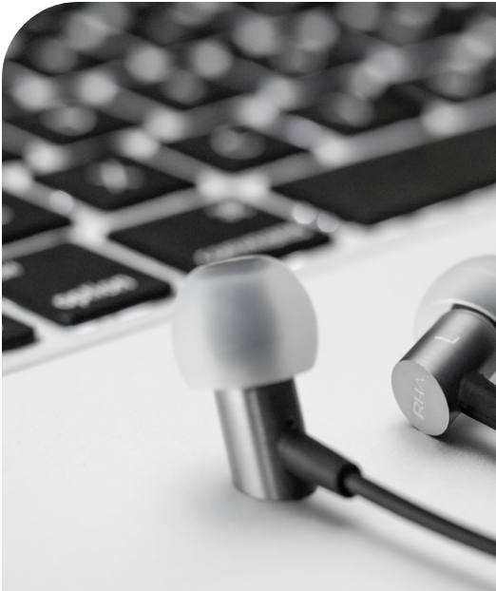


2019–2022
Sales Performance Report
Superstore 2019–2022
Built with:
Power BI
Data analytics Team — By Mohamed Abdi

Slide 2


Contents
01
02
03
04
Quick Summary
How We Did This (Tools & KPIs)
Sales Trend (2019–2022)
Category Results
05
06
07
08
Region Profit Results
Customer Segments
Product Results
Key Points & Conclusion
Superstore Sales Performance Report | 2019–2022
02

Slide 3







Quick Summary
From 2019 to 2022, sales grew each year. Technology sells the most. The West region and Consumer customers bring the most profit.
2.30M
286.4K
5K
12.47%
Total Sales
Total Profit
Total Orders
Profit Margin
Key Highlights
Best Sales Year
Most Profitable Region
Most Profitable Segment
2022
West
Consumer
Superstore Sales Performance Report | 2019–2022
03

Slide 4












How We Did This (Tools & KPIs)
Tools Used
Process Flow
Power BI
Build charts and dashboards
Superstore Data
DAX
Create KPI calculations
Cleaning Data
Data Model
Connect tables so reports work correctly
Data Model
KPI Meanings
Total Sales
Total Profit
DAX Measures
All revenue
Money left after costs
Total Orders
Profit Margin
Charts & Insights
Number of orders
Profit ÷ Sales
Superstore Sales Performance Report | 2019–2022
4

Slide 5


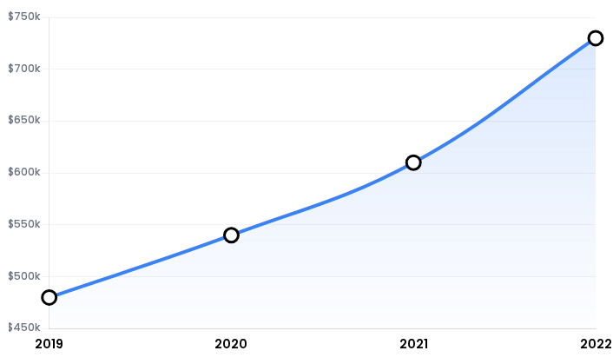


Sales Trend (2019–2022)
Overall Profit Margin
12.47%
Key Insight
Sales have shown a consistent upward trajectory over the 4-year period, culminating in 2022 recording the highest sales figures to date.
Superstore Sales Performance Report | 2019–2022
5

Slide 6


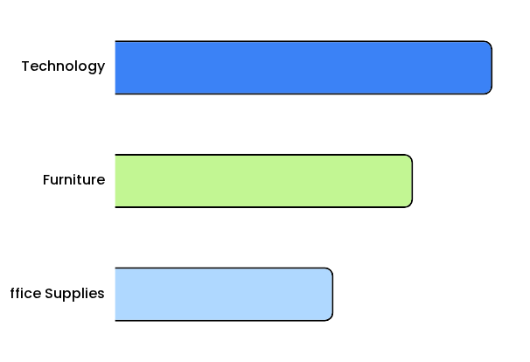
Category Results
Technology generated the highest sales among all categories.
Furniture ranked second, while Office Supplies produced slightly lower sales.
Technology products are the most important revenue drivers for the business.
Superstore Sales Performance Report | 2019–2022
6

Slide 7


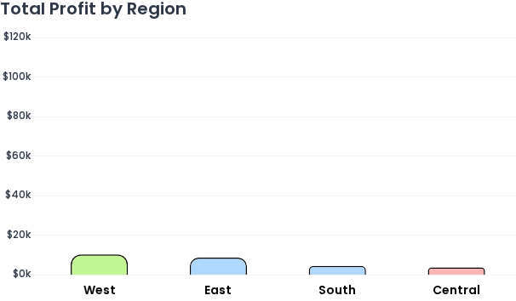



Region Profit Results
1
West Region Success
Do more of what works in the West
2
Central Region Issues
Check why Central is low (discounts, shipping costs, product mix)
Superstore Sales Performance Report | 2019–2022
7

Slide 8


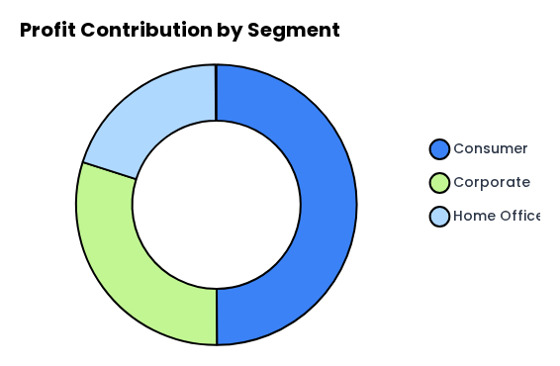

Customer Segments
Consumer customers bring the most profit. Corporate and Home Office bring less.
What this means:
Keep Consumer customers happy (offers, good service)
Create better deals for Corporate and Home Office to raise profit
Superstore Sales Performance Report | 2019–2022
08

Slide 9

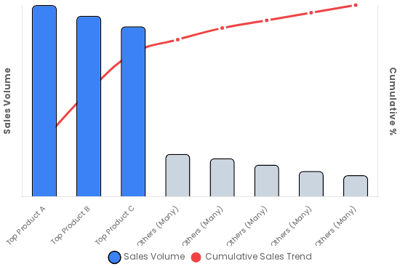






Product Results
Sales Contribution by Product
Review in Product Details:
Sales
Profit
Quantity Sold
Protect Top Products
Ensure stock availability and consider promotions.
Review Low-Profit Products
Analyze pricing strategy and discount structures.
Superstore Sales Performance Report | 2019–2022
9

Slide 10



Key Points & Conclusion
Sales grew from 2019 to 2022
Consumer segment has the highest profit
Technology has the highest sales
Sales are focused on a small number of top products
West has the highest profit
Conclusion
Next steps
Keep investing in what works (Technology, West, Consumer) and improve weaker areas (Central, lower-profit segments/products).
Look deeper into why Central profit is low
Test new offers for Corporate and Home Office
Review products using Sales, Profit, and Quantity
Superstore Sales Performance Report | 2019–2022
10

Slide 11



Thank You
Questions?

